Slide 1

Part1: Three-Phase Full Bridge Rectifier (thyristor)
Wang Xingyi
Wang Yusong
Wang Jiaxu
Class3 _Group 4
Notes:
添加设计方向、设计独特性、n应用要扩充；建设内容要扩充；李处建议：1、个人身份介绍，我是陕西高等教育大数据中心主任**，我代表教育厅汇报。。。设计情况 2、简单介绍书 ，很多做了拉页处理，大事记可以放到ppt，在省政务大数据局支持和指导下，投入多少人多少天完成项目3、

Slide 2
CONTENTS
01
Simulation Schematic
Rectification Mode
02
PART
PART
03
Active Inversion Mode
PART

Slide 3
Division of Work
Wang Xingyi: Introduction to the Simulation model
Wang Yusong: Result of Rectification Mode
Wang Jiaxu: Result of Active Inversion Mode

Slide 4
Simulation Schematic
PART. 01

Slide 5
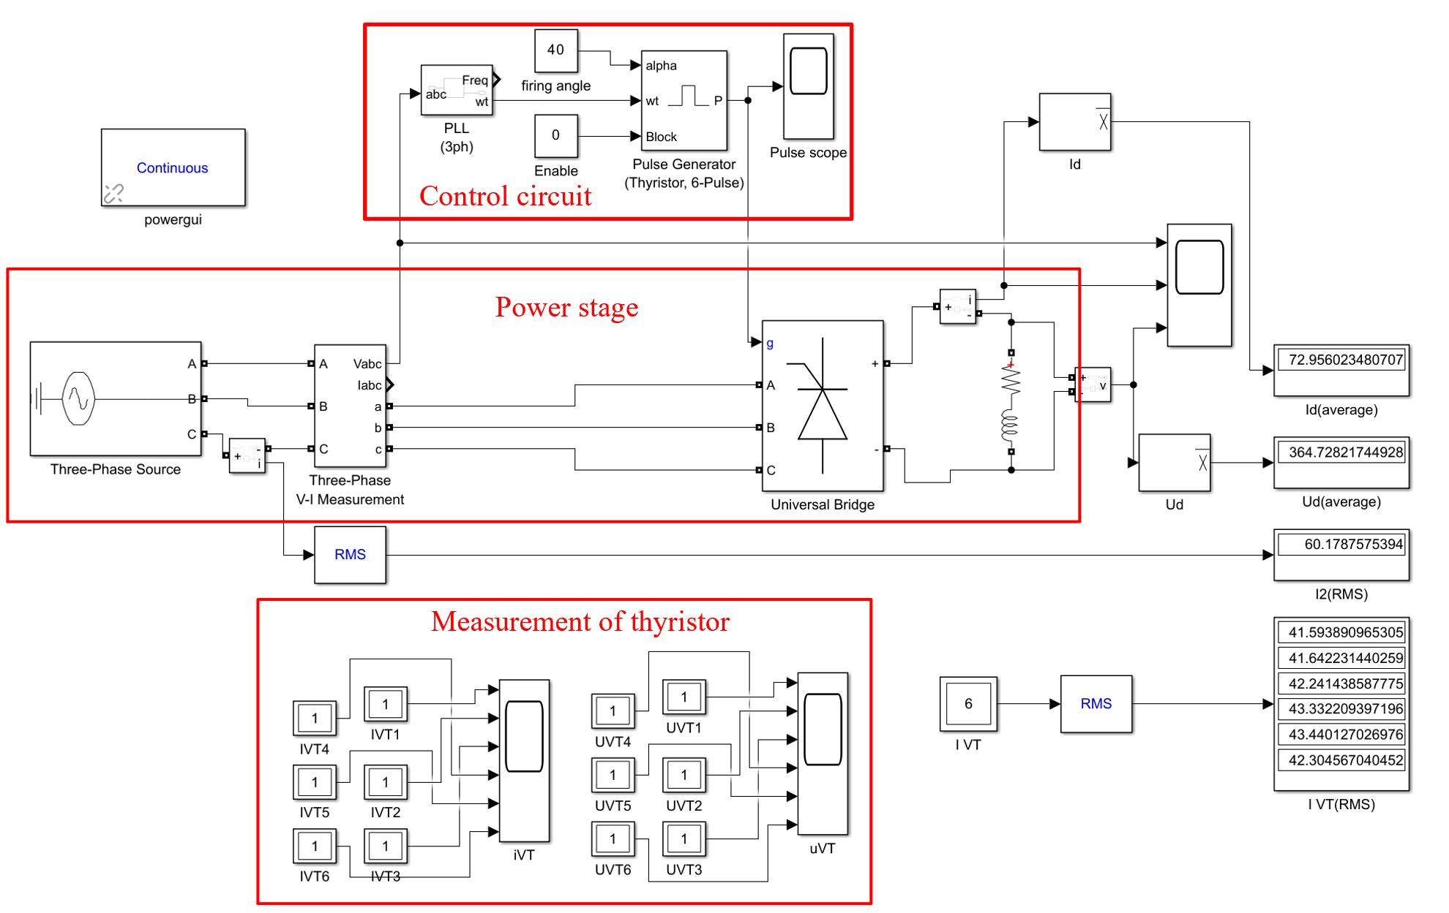
Rectification Mode
Parameters | values
R | 5Ω
L | 5mH
α (Rectification) | 40°
α (Inversion) | 120°
E | -530V

Slide 6
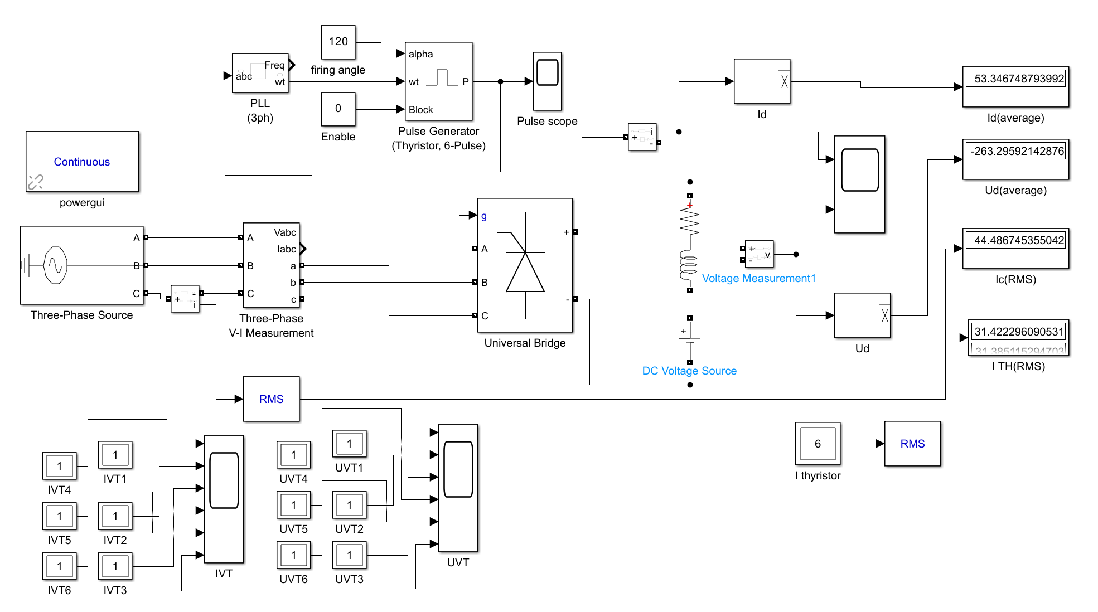
Active Inversion Mode
Parameters | values
R | 5Ω
L | 5mH
α (Rectification) | 40°
α (Inversion) | 120°
E | -530V

Slide 7
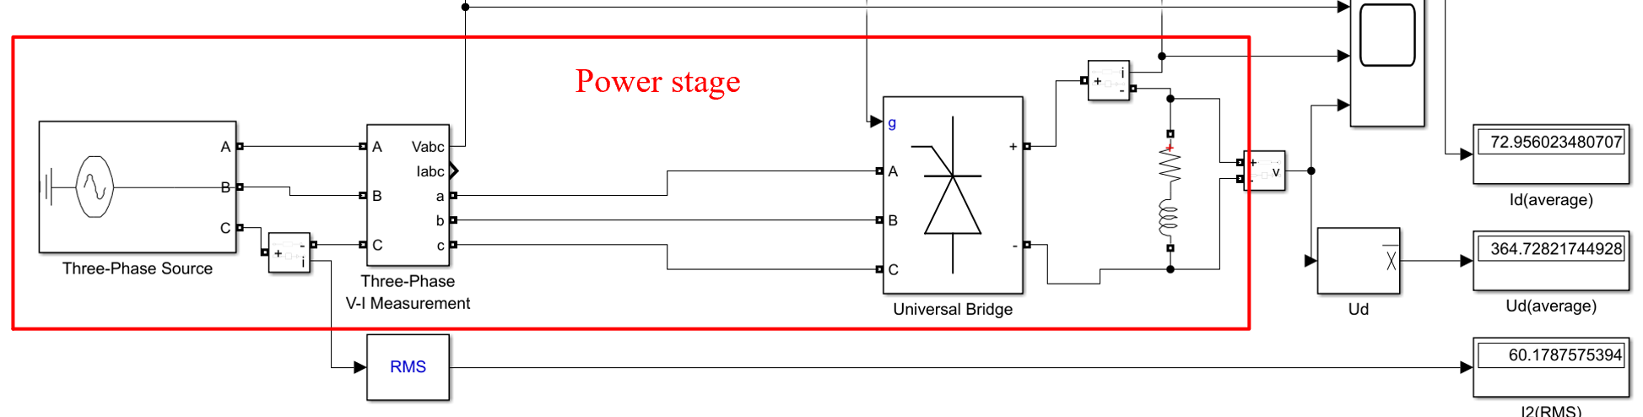
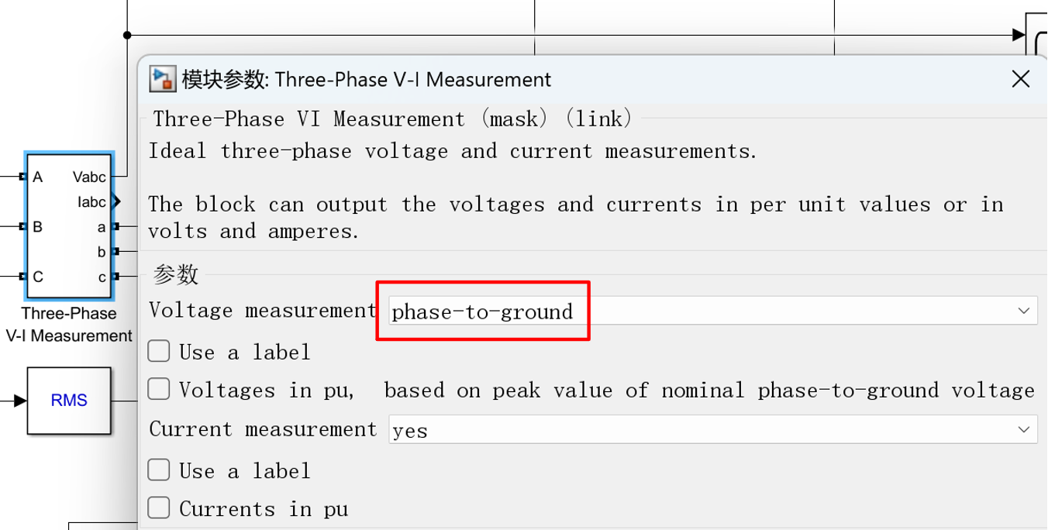
Power Stage
Parameters | values
R | 5Ω
L | 5mH
α (Rectification) | 40°
α (Inversion) | 120°
E | -530V

Slide 8
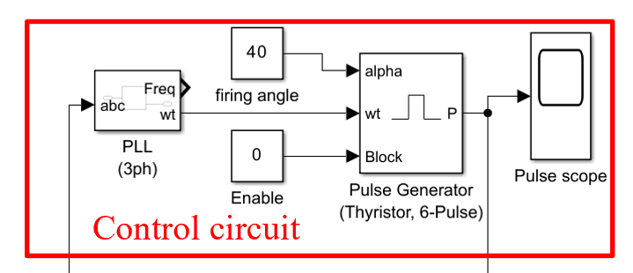
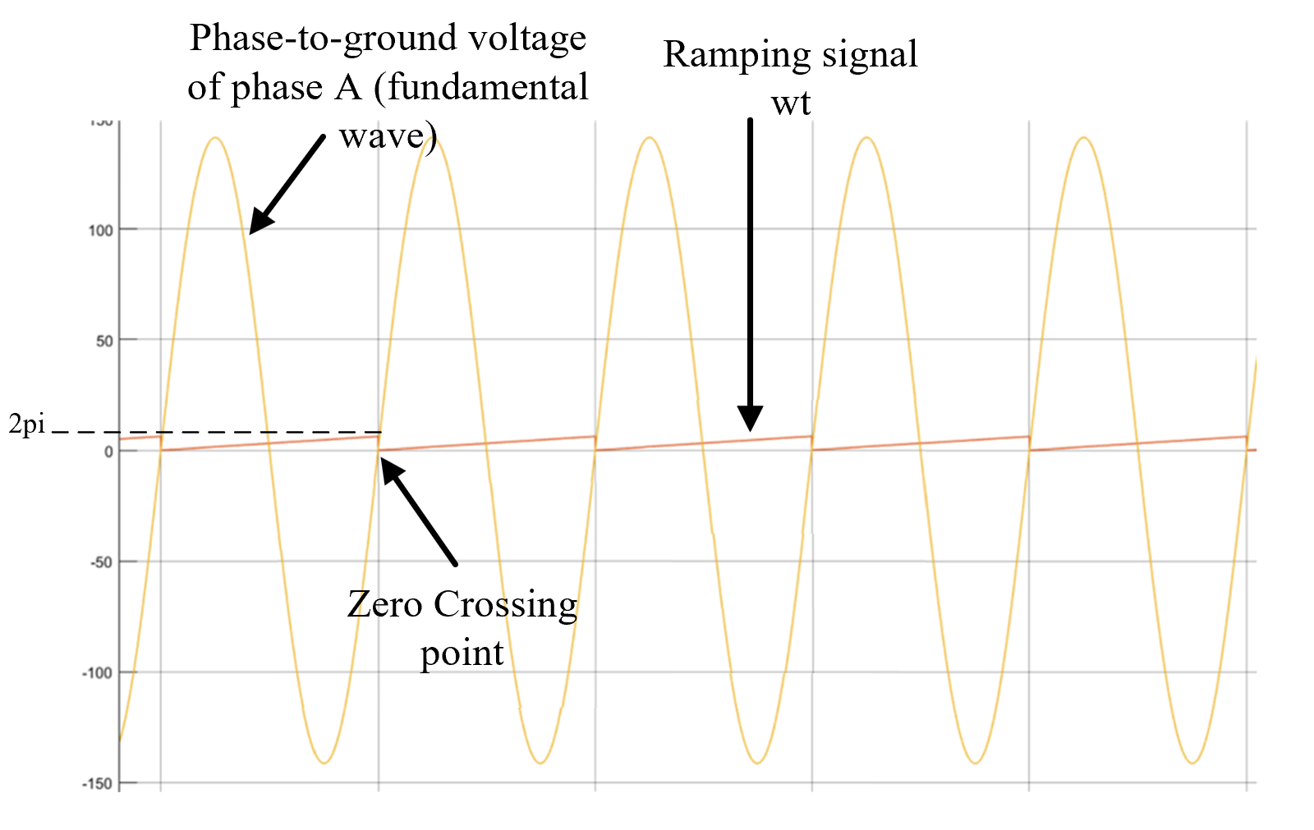
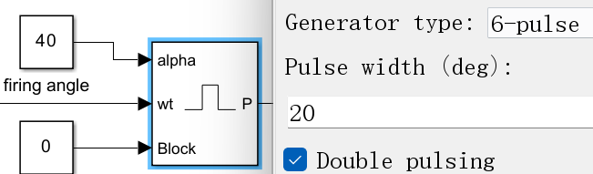
Control Circuit
Output of Phase Locked Loop (red line)
PLL: Provide “reference point” for firing angle

Slide 9
PART. 02
Rectification Mode

Slide 10
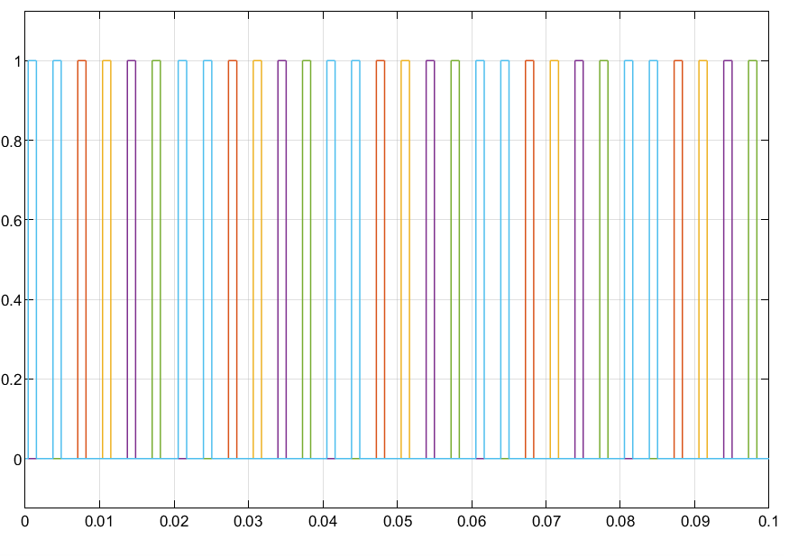
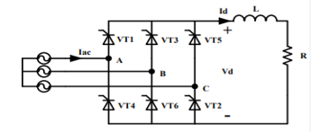
Rectification Mode
phase angel | 70°~130° | 130°~190° | 190°~250° | 250°~310° | 310°~10° | 10°~70°
Common cathode group | VT1 | VT1 | VT3 | VT3 | VT5 | VT5
Common anode group | VT6 | VT2 | VT2 | VT4 | VT4 | VT6
Notes:
circuit diagram
trigger signal of thyristor
The natural commutation point of the three-phase fully controlled bridge is set to 30 degree, and the delay angel α is 40 degree. VT1 conducts from 70 to130.VT2 conducts from 130 to 250.

Slide 11
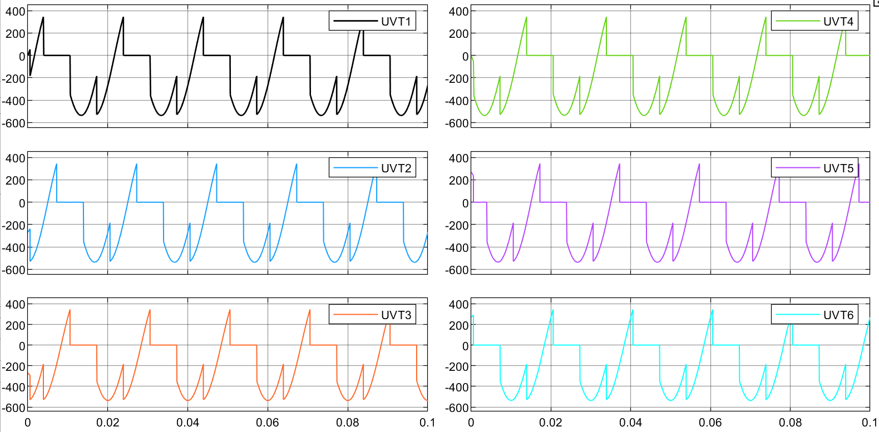
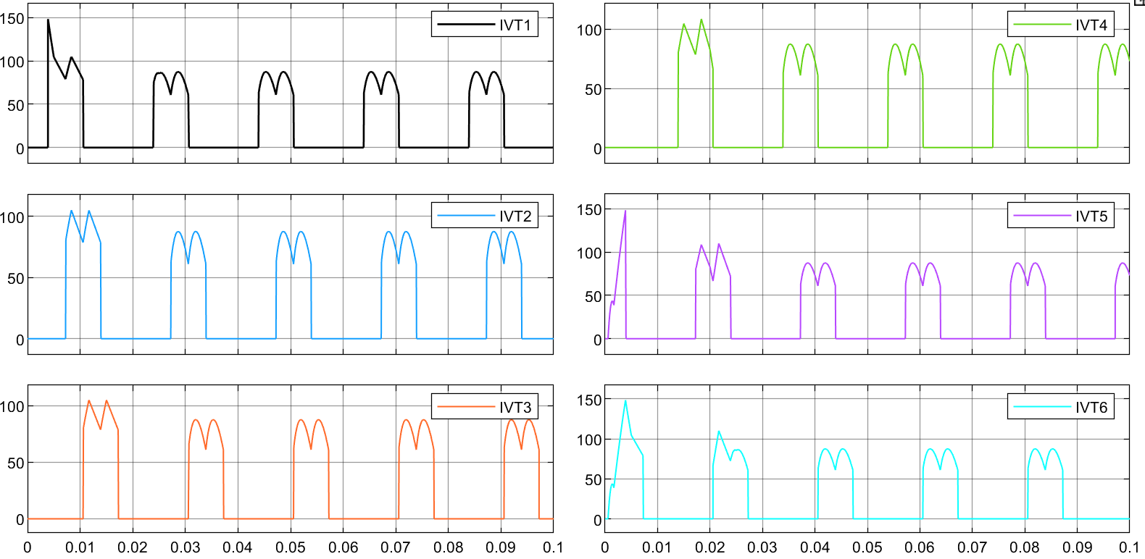
Rectification Mode
Voltage waveform of thyristor Current waveform of thyristor

Slide 12
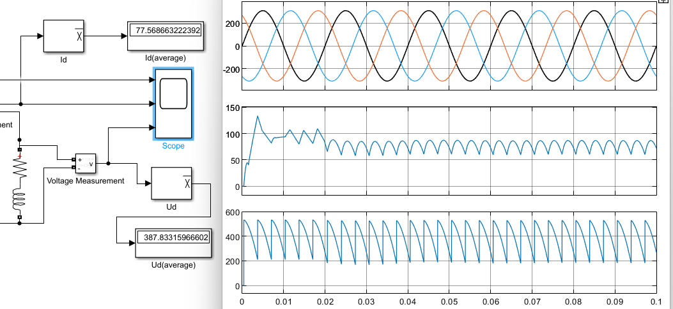
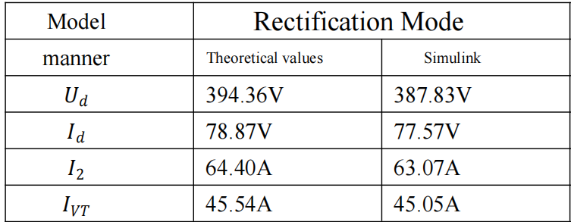
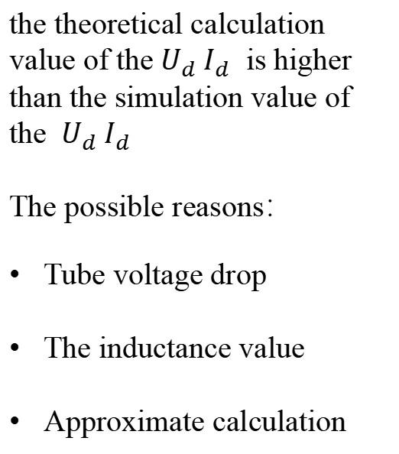
Rectification Mode
the theoretical calculation value of the${ U}_{d} I_{d}$ is higher than the simulation value of the ${ U}_{d} I_{d}$
The possible reasons：
Tube voltage drop
The inductance value
Approximate calculation
Notes:
the voltage waveform of load the current wavefuorm of load
1)The thyristor will produce a voltage drop when it is turned on, which causes the analog value to be lower than the theoretical calculation value.
2)The inductance value is defined as infinite in theoretical calculation while is a finite value in simulation.
3)The theoretical calculation is actually a approximate calculation, for example, 根号6 ≈2.34，which have a influence on the results.
4)Essentially, MATLAB simulation calculation is Calculation of discrete points , which is also a approximate calculation.

Slide 13
Active Inversion Mode
PART. 03

Slide 14
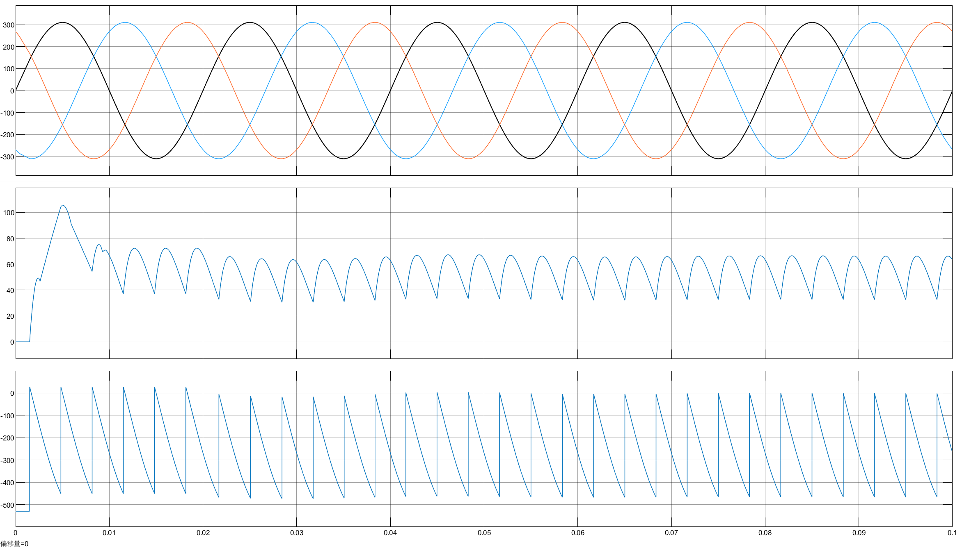
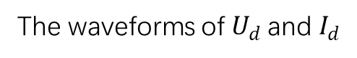
Active Inversion Mode
The waveforms of$U_{d}$ and $I_{d}$

Slide 15
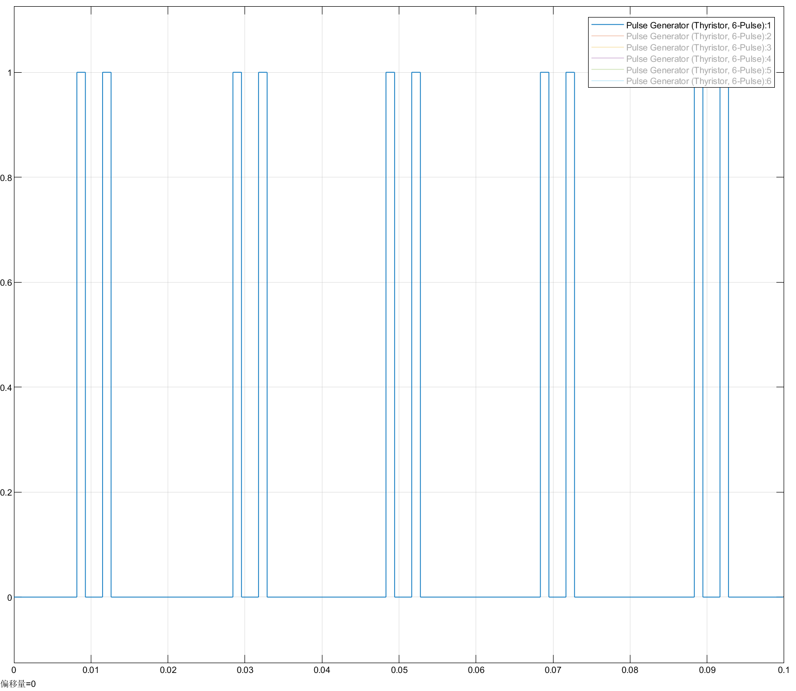
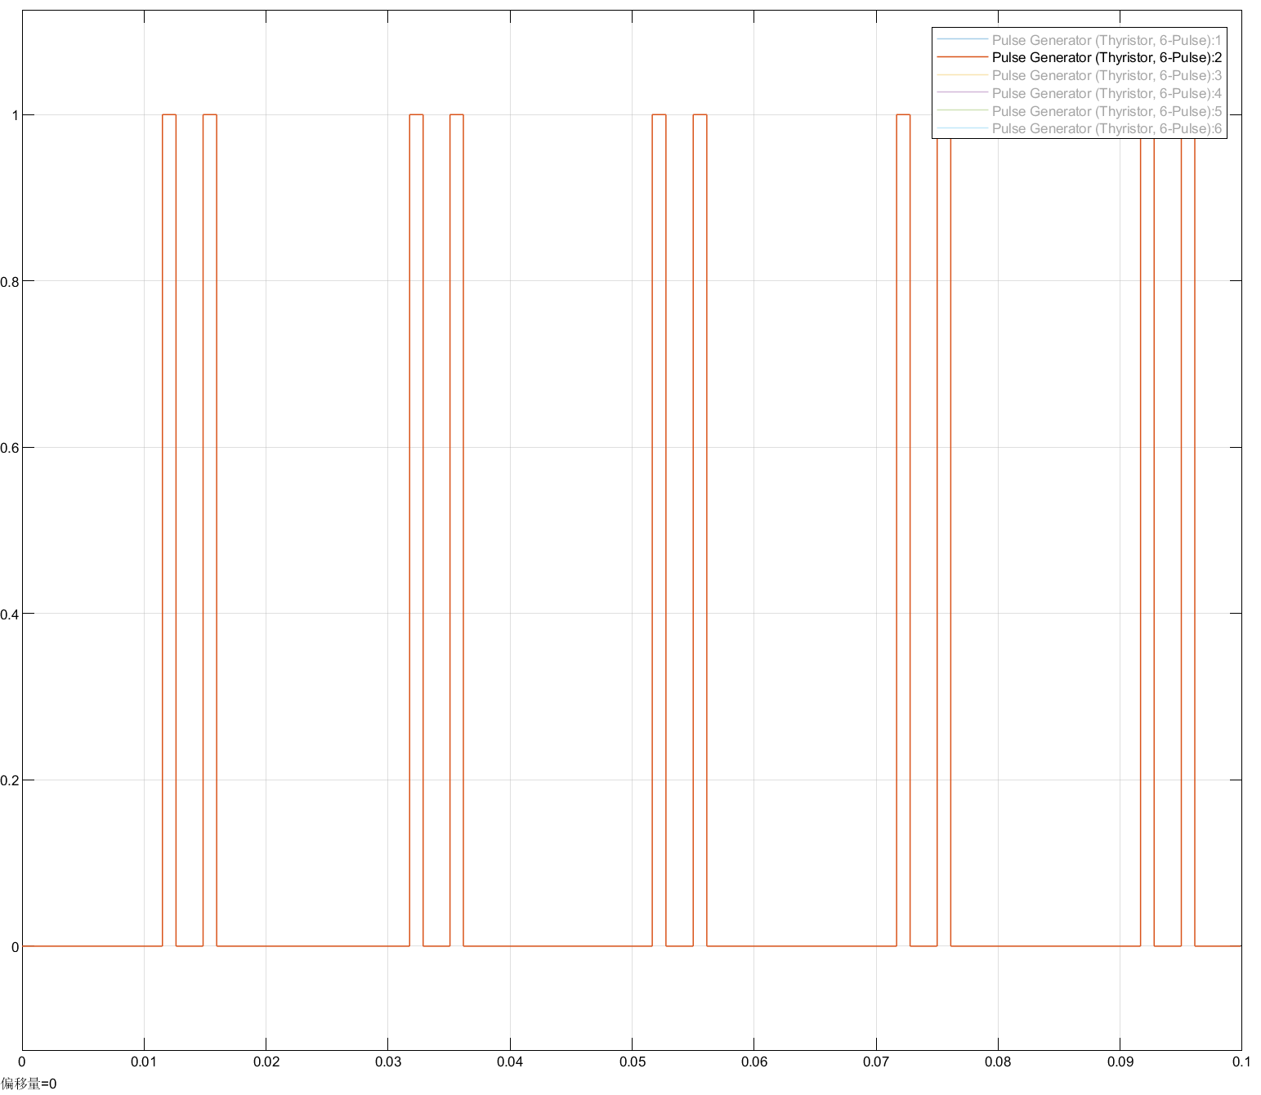
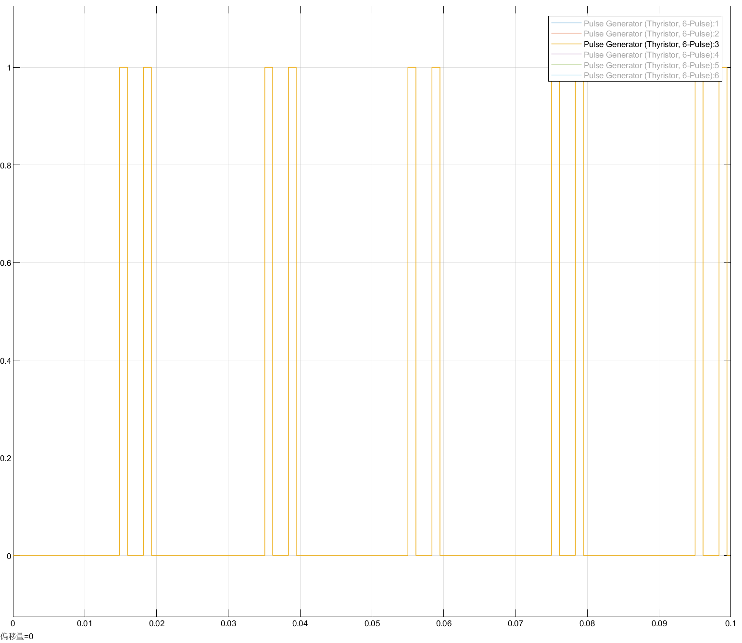
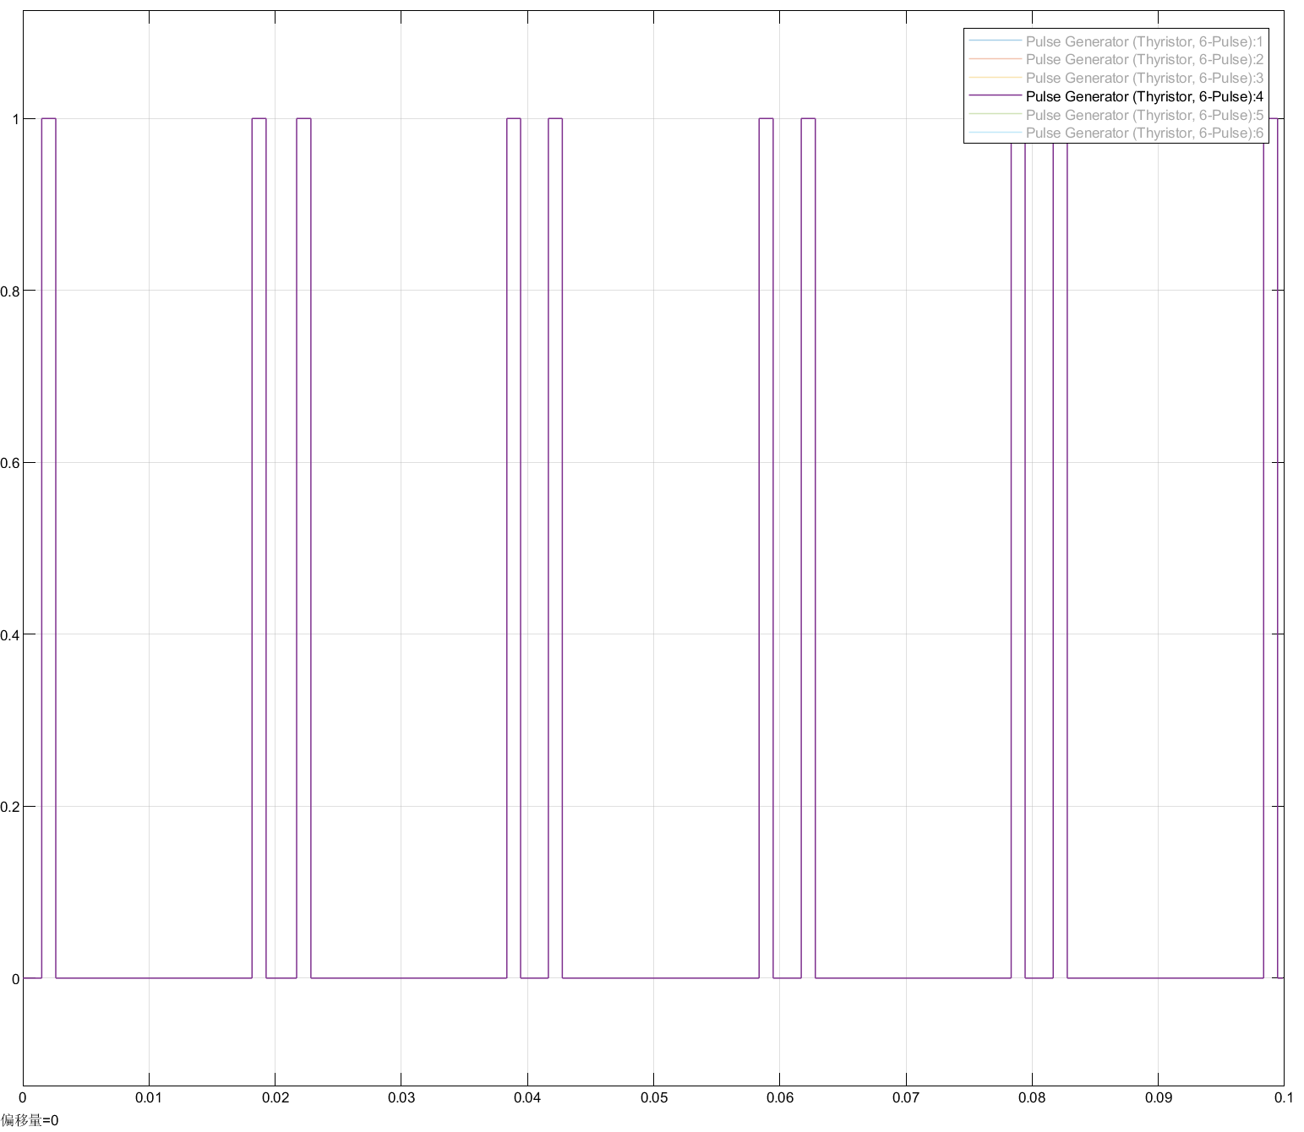
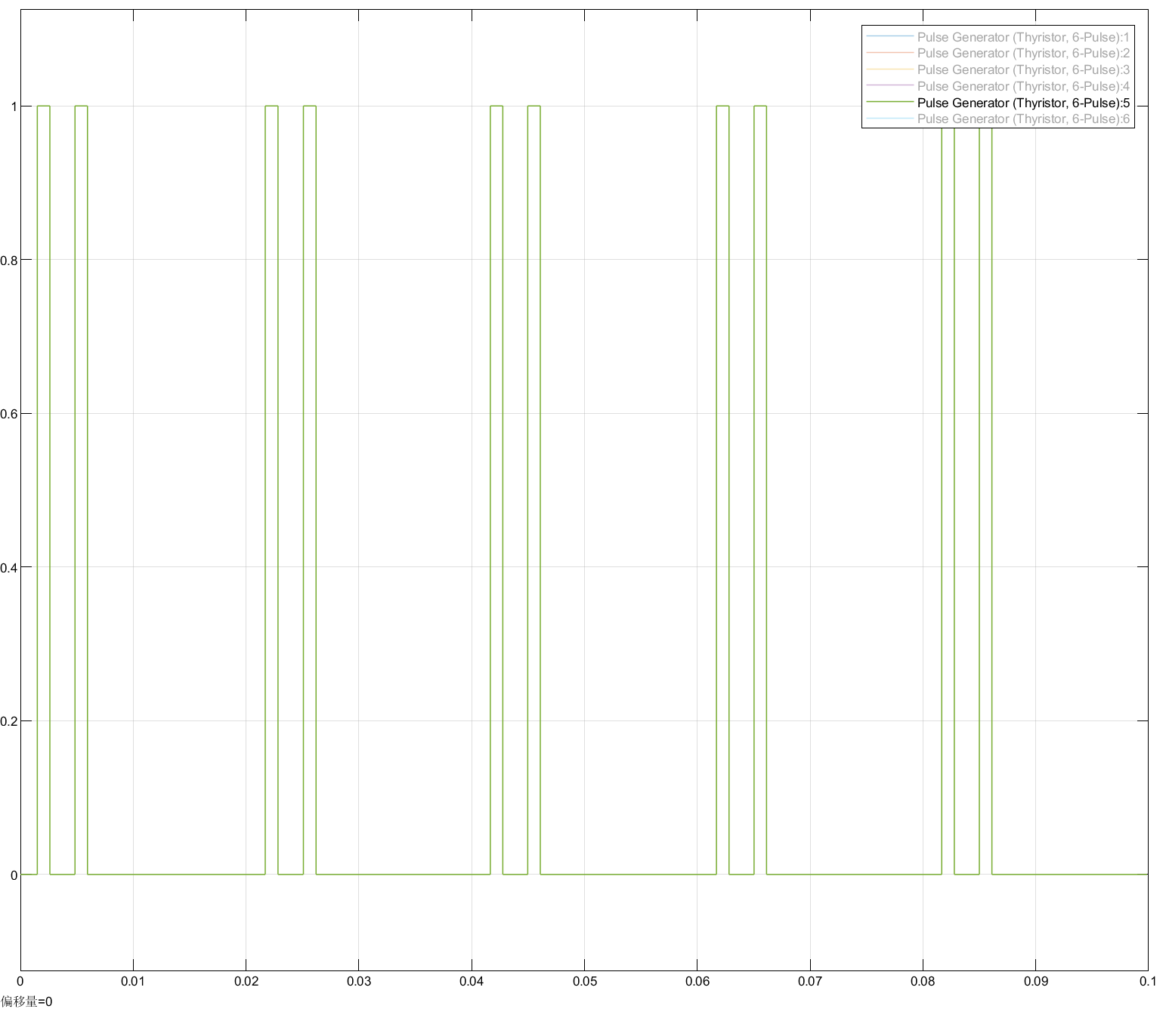
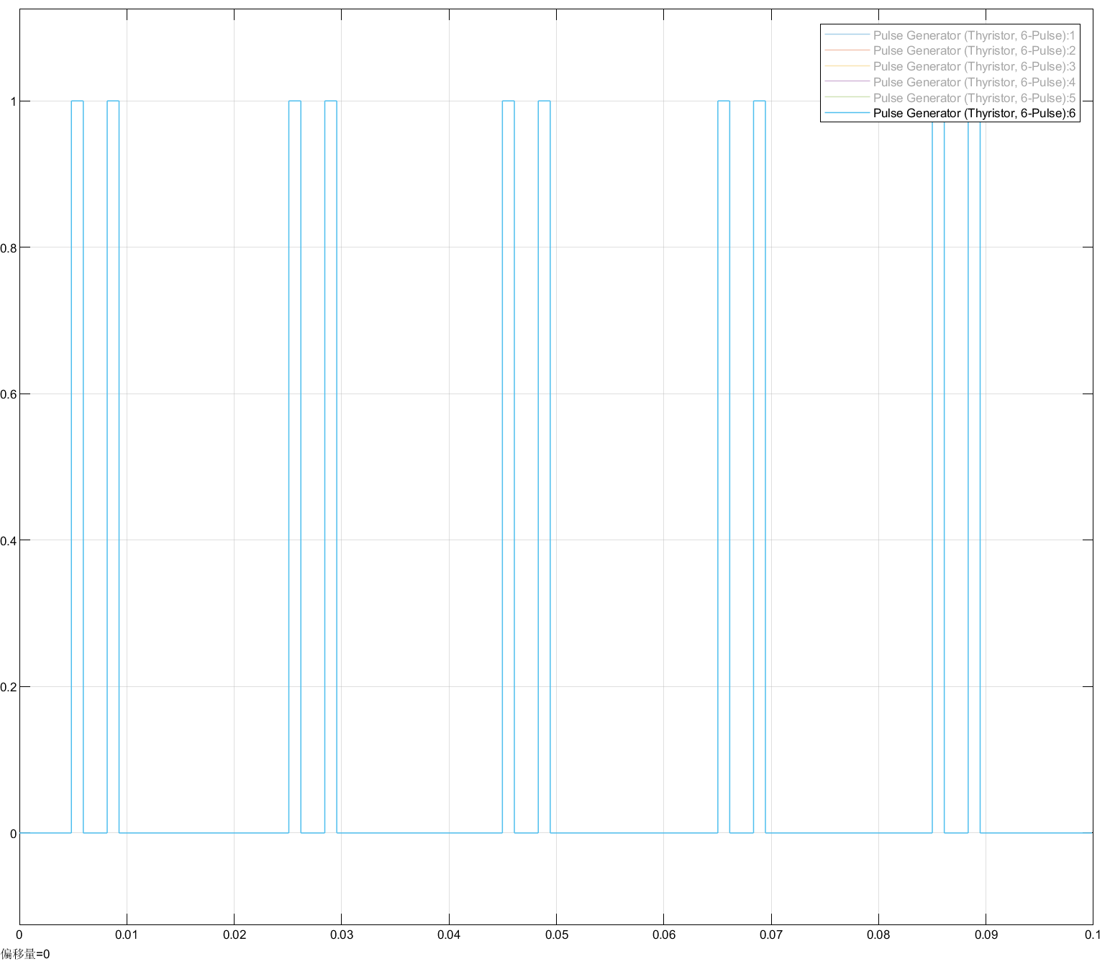
Active Inversion Mode

Slide 16
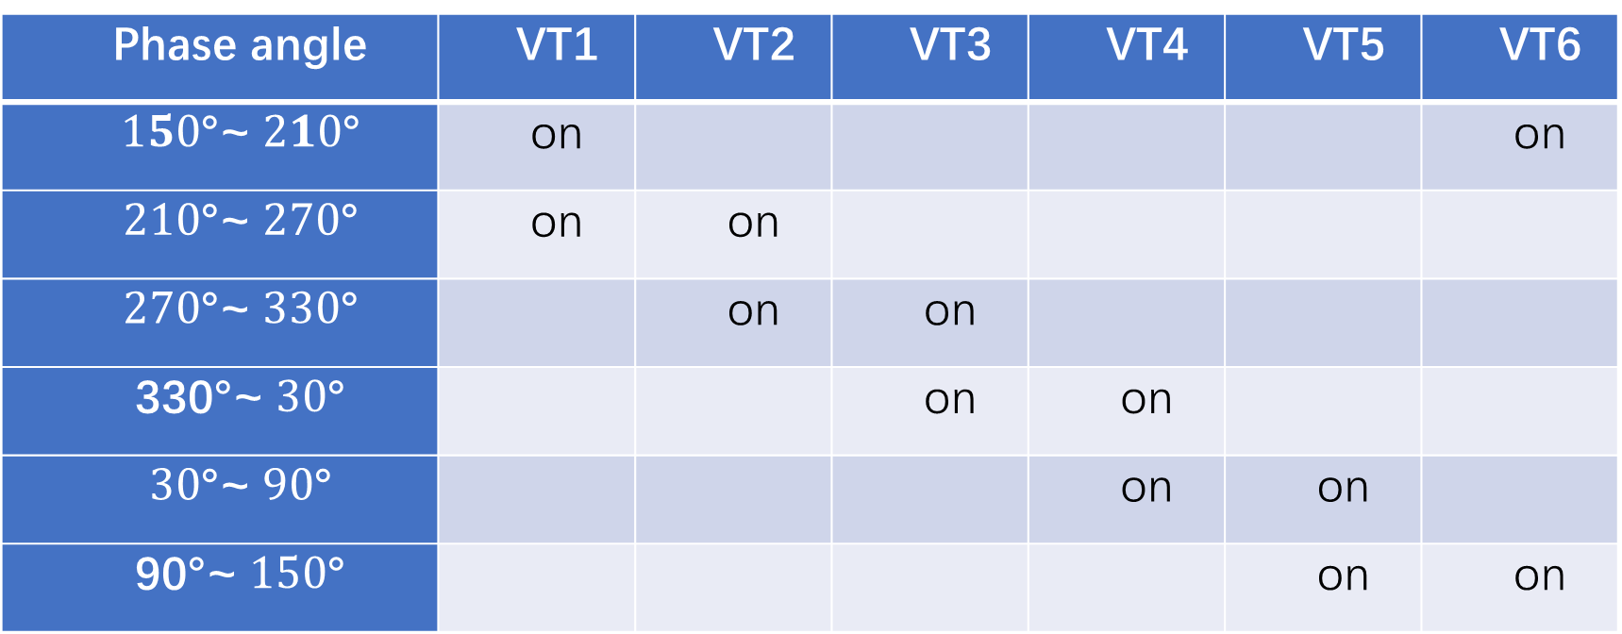
Active Inversion Mode
Phase angle | VT1 | VT2 | VT3 | VT4 | VT5 | VT6
$150$°~$210$° | on |  |  |  |  | on
$210$°~$270$° | on | on
$270$°~$330$° |  | on | on
330°~$30$° |  |  | on | on
$30$°~$90$° |  |  |  | on | on
90°~$150$° |  |  |  |  | on | on

Slide 17
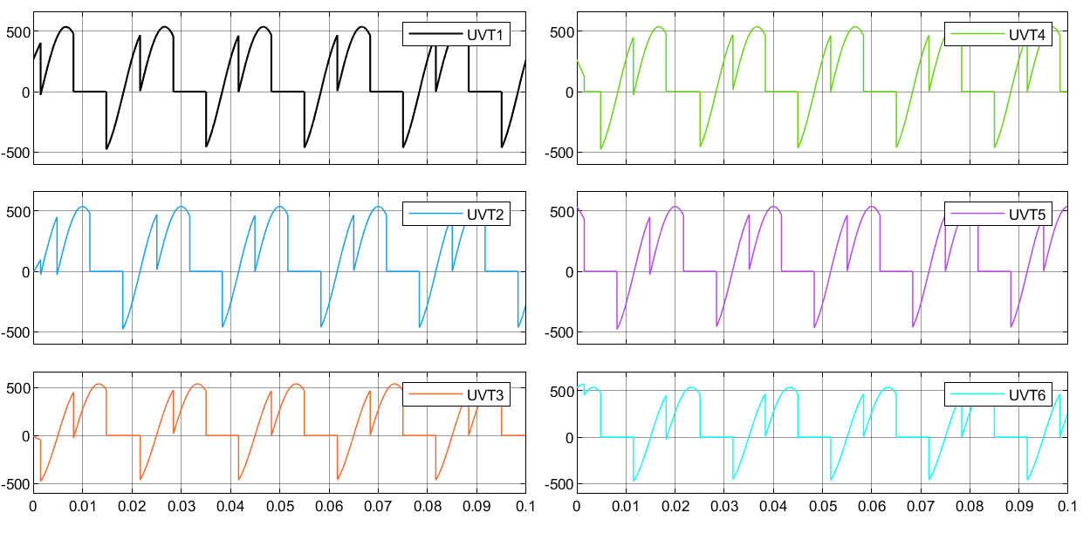
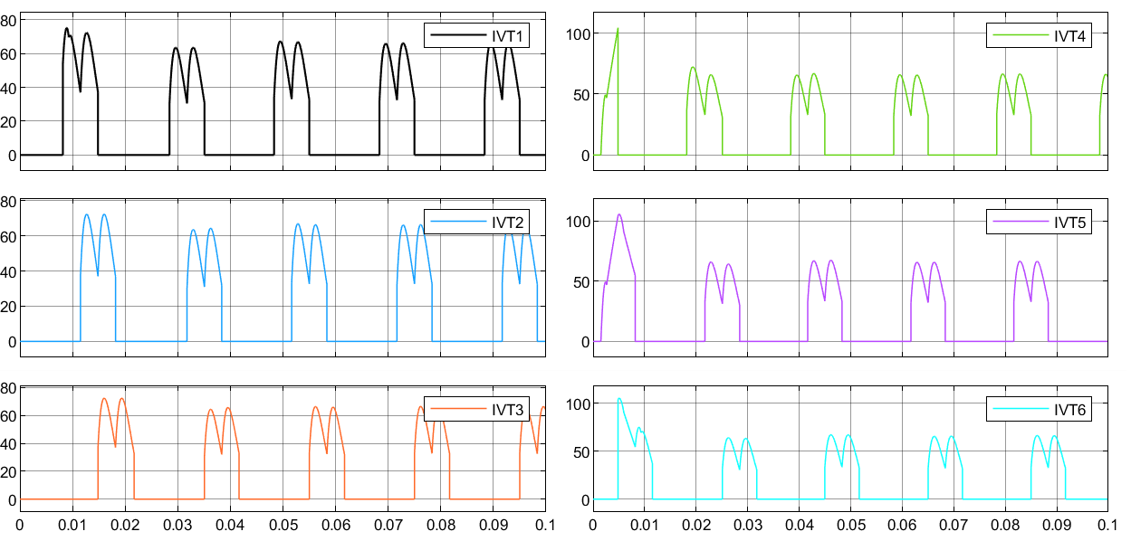
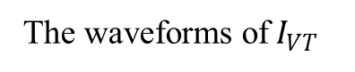
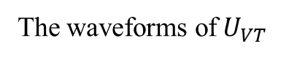
Active Inversion Mode
The waveforms of$U_{VT}$
The waveforms of$I_{VT}$

Slide 18
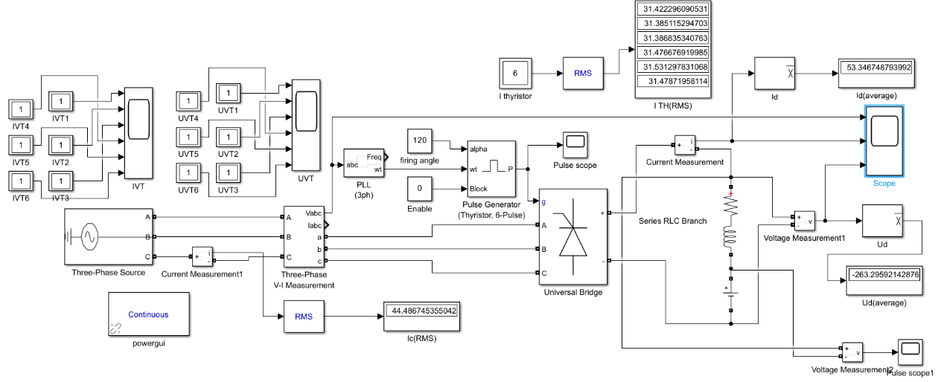
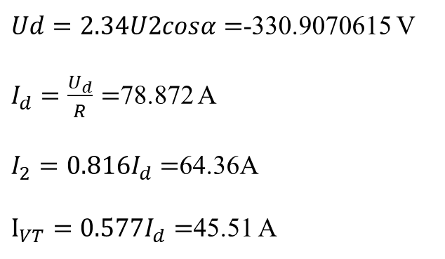
Active Inversion Mode
Theoretical Value
Simulation Value
$Ud=2.34U2cosα=$-330.9070615 V
$I_{d}=\frac{U_{d}}{R}=$78.872 A
$I_{2}=0.816I_{d}=$64.36A
$I_{VT}=0.577I_{d}=$45.51 A

Slide 19
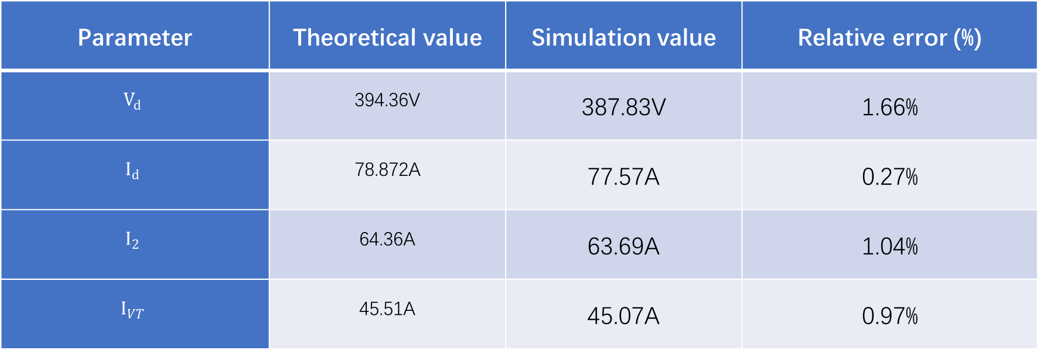
Active Inversion Mode
Parameter | Theoretical value | Simulation value | Relative error (%)
$$V_{d}$$ | 394.36V | 387.83V | 1.66%
$$I_{d}$$ | 78.872A | 77.57A | 0.27%
$$I_{2}$$ | 64.36A | 63.69A | 1.04%
$$I_{VT}$$ | 45.51A | 45.07A | 0.97%

Slide 20
Part2: Three-Phase Full Bridge Rectifier (Power Diode)
Wang Xingyi
Wang Yusong
Wang Jiaxu
Class3_Group 4
Notes:
添加设计方向、设计独特性、n应用要扩充；建设内容要扩充；李处建议：1、个人身份介绍，我是陕西高等教育大数据中心主任**，我代表教育厅汇报。。。设计情况 2、简单介绍书 ，很多做了拉页处理，大事记可以放到ppt，在省政务大数据局支持和指导下，投入多少人多少天完成项目3、

Slide 21
Division of Work
Wang Yusong: Simulation Schematic and Code
Wang Xingyi: Output Voltage
Wang Jiaxu: THD and Power Factor

Slide 22
CONTENTS
01
Model Analysis
PART
03
THD and
Power Factor
02
Output Voltage
PART
PART

Slide 23
PART. 01
Model analysis

Slide 24
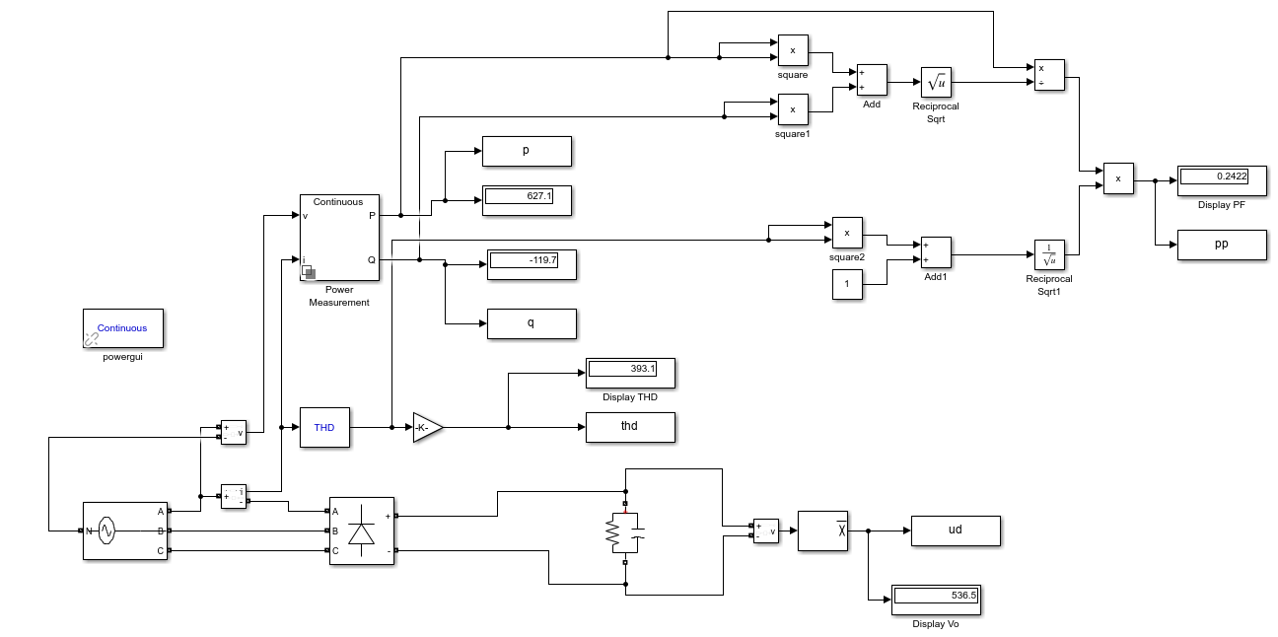
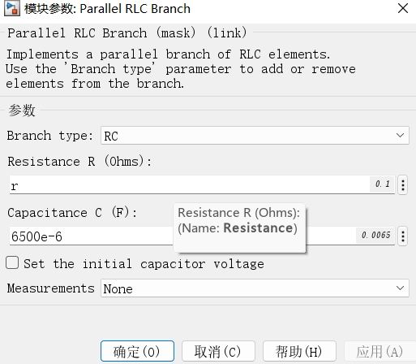
Simulink Model
Change the value of the variable r to obtain the load of different parameters.
Notes:
this is the simulink model of diode bridge with capacitive load. we change the value of the variable r to obtain the load of different parameters.

Slide 25
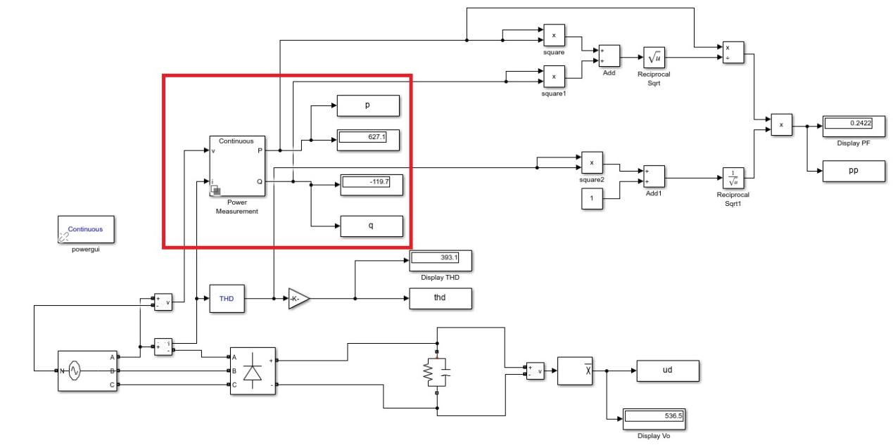
Simulink Model
This part is used to measure the active and reactive power of the fundamental wave
Notes:
This part is used to measure the active and reactive power of the fundamental wave. reactive power generated by harmonic current is ignored. we ues the active and reactive power of the fundamental wave to caculation the power factor

Slide 26
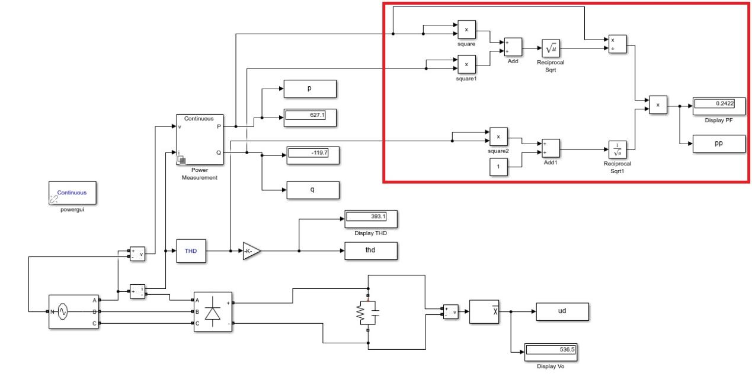
Simulink Model
This section is used to calculate power factor
Notes:
By calling the function module of simulink, this part realizes the calculation of power factor

Slide 27
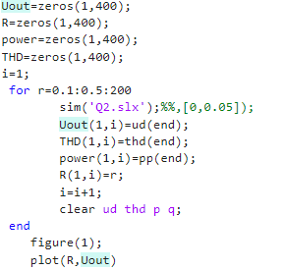
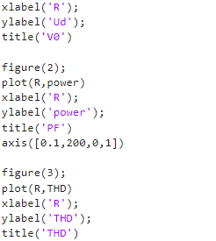
Program
In order to better simulate the Vo = f(RL);PF = f(RL);THD = f(RL), I wrote a program to control the Simulink.
Notes:
In order to better simulate the Vo = f(RL);PF = f(RL);THD = f(RL), I wrote a program to control the Simulink. change the value of resistance from 0.1 to 200.

Slide 28
PART. 02
Output Voltage

Slide 29
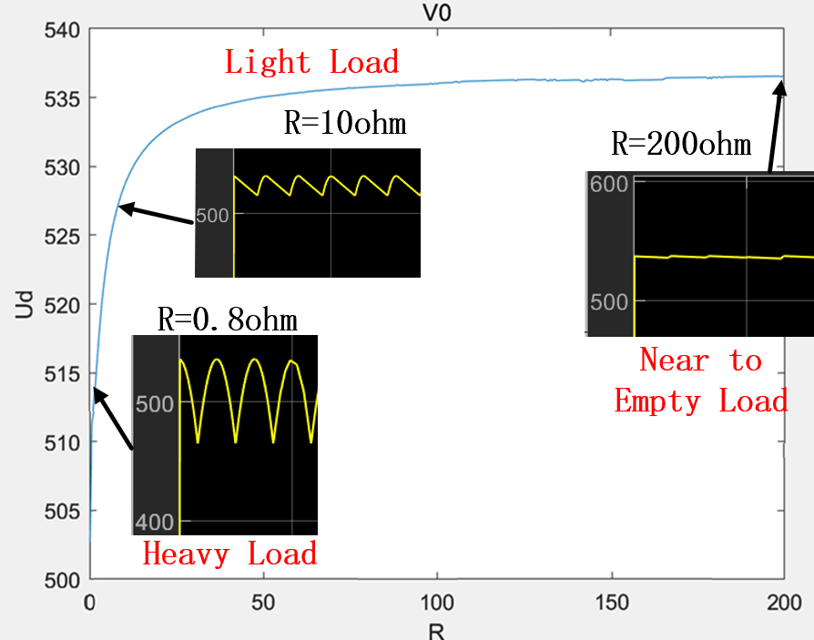
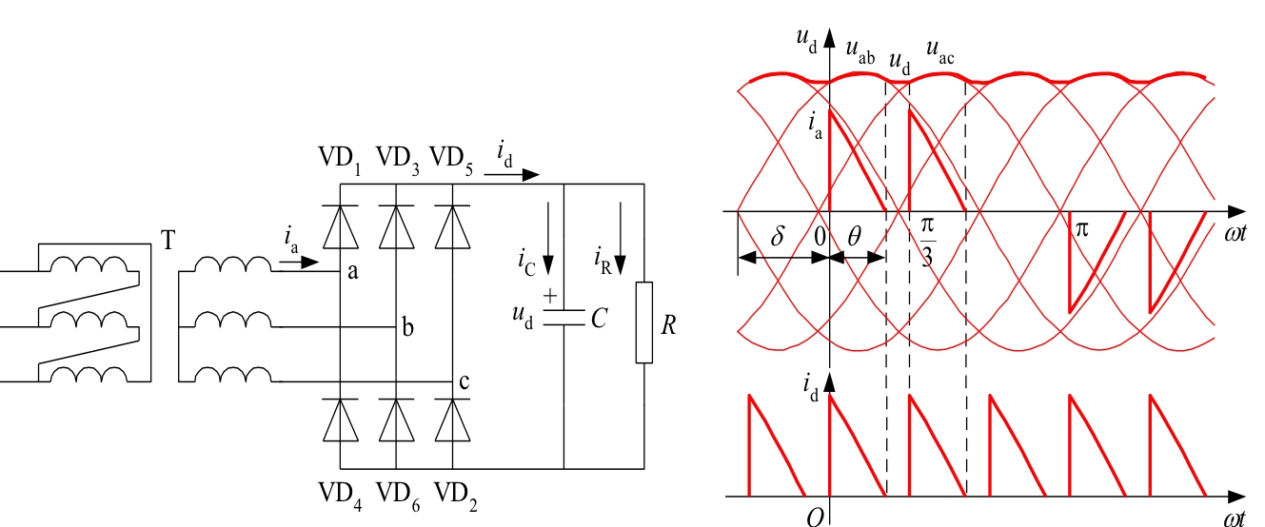
Vo
Critical condition for the current being continuous or intermittent:
Parameters | values
R | 0.1-200Ω (per 0.05 Ω)
C | 6.5mF
(Intermittent current)

Slide 30
THD and
Power Factor
PART. 03

Slide 31
THD

Slide 32
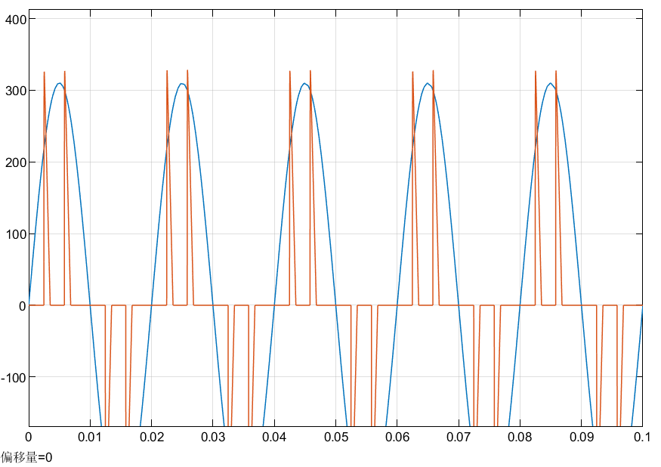
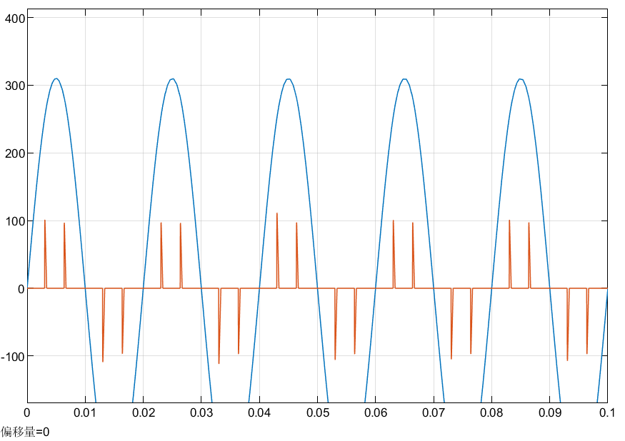
THD
R=100Ω
R=10Ω
the simulated waveforms of phase A AC voltage and current when R=10 and R=100

Slide 33
PF
$$λ=\frac{P}{S_{ALL}}=\frac{P}{\sqrt{P^{2}+Q^{2}}}×\frac{I_{1}}{I}=\frac{P}{\sqrt{P^{2}+Q^{2}}}×\frac{1}{\sqrt{1+{THD}^{2}}}$$
the displacement of the fundamental current
the distortion of the current waveform

Slide 34
谢谢大家

